Slide 1
Ratings Prediction Project
Submitted By:
SYED MUGERA BILAL
syedbilalarmaan@gmail.com

Slide 2
Contents
Introduction
Problem Statement
Data Collection Phase
Model Building Phase
Project Flow
Hardware, Software and Tools
Data Preprocessing
Missing Values
Word and Character count
Ratings Plot / Bar Plot / Count Plots
Word Cloud
Splitting the data
Building Machine Learning Algorithms
Evaluation and Cross validation of ML Models
Hyper parameter Tuning
Saving and Loading the model
Conclusion

Slide 3
INTRODUCTION
This is a Machine Learning Project performed on customer reviews. Reviews are processed using common NLP techniques.
Millions of people use Amazon and Flipkart to buy products. For every product, people can rate and write a review. If a product is good, it gets a positive review and gets a higher star rating, similarly, if a product is bad, it gets a negative review and lower star rating. My aim in this project is to predict star rating automatically based on the product review.
The range of star rating is 1 to 5. That means if the product review is negative, then it will get low star rating (possibly 1 or 2), if the product is average then it will get medium star rating (possibly 3), and if the product is good, then it will get higher star rating (possibly 4 or 5).
This task is similar to Sentiment Analysis, but instead of predicting the positive and negative sentiment (sometimes neutral also), here we need to predict the rating.

Slide 4
PROBLEM STATEMENT
The rise in e-commerce has brought a significant rise in the importance of customer reviews. There are hundreds of review sites online and massive amounts of reviews for every product. Customers have changed their way of shopping and according to a recent survey, 70 percent of customers say that they use rating filters to filter out low rated items in their searches.
The ability to successfully decide whether a review will be helpful to other customers and thus give the product more exposure is vital to companies that support these reviews, companies like Google, Amazon, Flipkart etc.
There are two main methods to approach this problem. The first one is based on review text content analysis and uses the principles of natural language process (the NLP method). This method lacks the insights that can be drawn from the relationship between costumers and items. The second one is based on recommender systems, specifically on collaborative filtering and focuses on the reviewer’s point of view.

Slide 5
DATA COLLECTION PHASE
You have to scrape at least 20000 rows of data. You can scrape more data as well, it’s up to you. More the data better the model. In this section you need to scrape the reviews of different laptops, Phones, Headphones, smart watches, Professional Cameras, Printers, monitors, home theatre, router from different e-commerce websites.
Basically, we need these columns:
1) reviews of the product.
2) rating of the product.
Fetch an equal number of reviews for each rating, for example if you are fetching 10000 reviews then all ratings 1,2,3,4,5 should be 2000. It will balance our data set. Convert all the ratings to their round number as there are only 5 options for rating i.e., 1,2,3,4,5. If a rating is 4.5 convert it 5.

Slide 6
MODEL BUILDING PHASE
After collecting the data, you need to build a machine learning model. Before model building do all data pre-processing steps involving NLP. Try different models with different hyper parameters and select the best model. Follow the complete life cycle of data science. Include all the steps mentioned below:
1. Data Cleaning
2. Exploratory Data Analysis and Visualization
3. Data Pre-processing
4. Model Building
5. Model Evaluation
6. Selecting the Best classification model

Slide 7
PROJECT FLOW
Web Scraping
EDA
Ensure that the webpages allow legal scraping of data
Extract the product URL’s from Amazon and Flipkart
Check for missing values
Data Preprocessing steps
Create a dataframe with Reviews and Ratings columns
Save the dataframe in CSV format
Handle outliers and class imbalance to avoid model biasness
Visualization
Use Different plots to get initial insight on our dataset
Create various visualization plots and Word Cloud
Model Building
Function for Classification Models and Evaluation Metrics

Slide 8
Hardware, Software and Tools
For doing this project, we require laptop with high configuration and specification with a stable Internet connection.
Microsoft office, Anaconda distribution as software.
Python 3.x as programming language.
Jupyter Notebook as Editor which is in Anaconda navigator.
Some tools or libraries required like Numpy – used to numerical calculations. Pandas – used to data manipulation. Matplotlib and Seaborn – used to data visualization, Sklearn, missingno, NLTK.

Slide 9
DATA PREPROCESSING
Importing the necessary libraries/dependencies
Checking dataset dimensions and null value details
Taking a look at various label categories using the Unique method
Performing data cleaning and then visualization steps
Making Word Clouds for loud words in each label class
Handling the class imbalance issue manually and fixing it
Converting text into vectors using the TF-IDF Vectorizer
Splitting the dataset into train and test to build classification models
Evaluating the classification models with necessary metrics

Slide 10
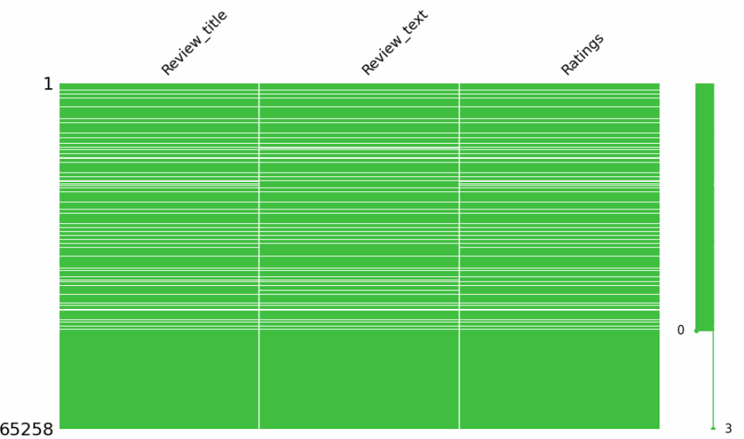
MISSING VALUES
I used the missingno matrix feature to get a visual on all the NaN values present in our dataset and then decided to drop them all so that we were left with meaningful information.

Slide 11
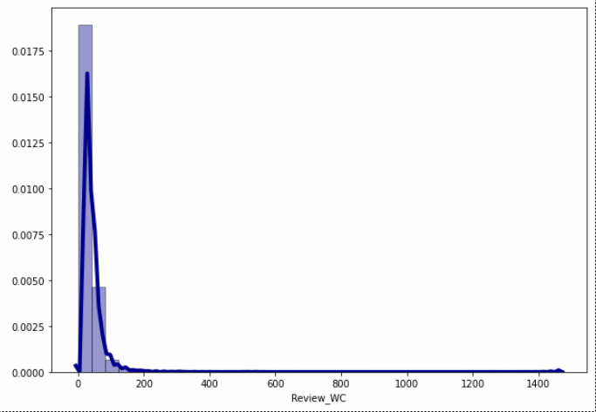
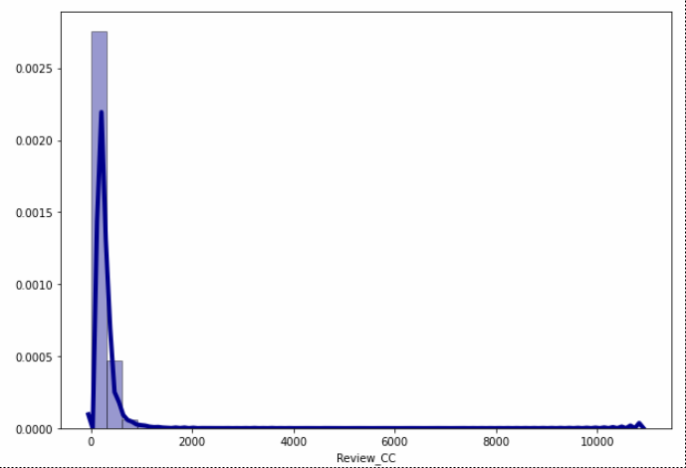
WORD AND CHARACTER COUNT
Created the histogram + distribution plots for Word Counts and Character Counts before and after cleaning the text data. We basically removed all the stop words, punctuations, smiley, special characters, white spaces etc.

Slide 12
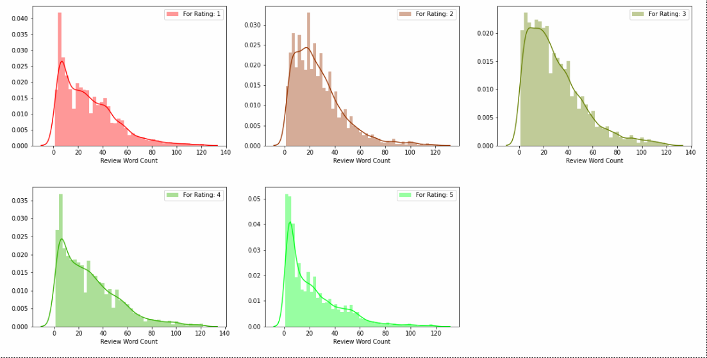
RATINGS PLOT
Created the histogram + distribution plots for our target label and observed each and every rating class for word counts as well as their character counts.

Slide 13
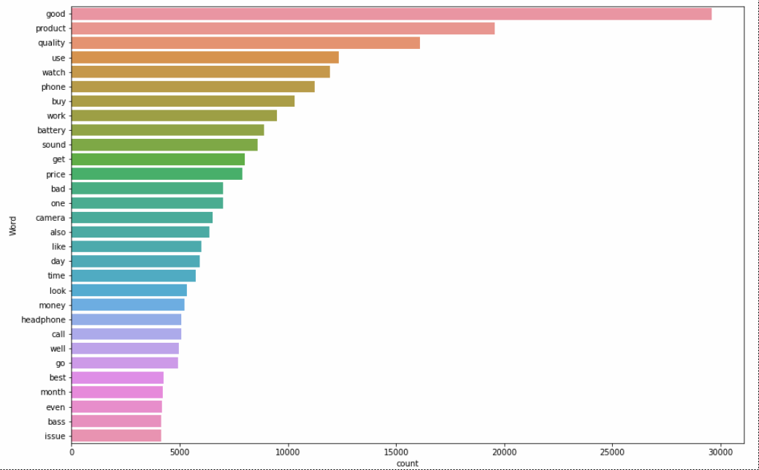
BAR PLOTS
Generated these bar plots for most frequently used words in review summary and least or rarely used words in a review summary by any customer in our dataset.

Slide 14
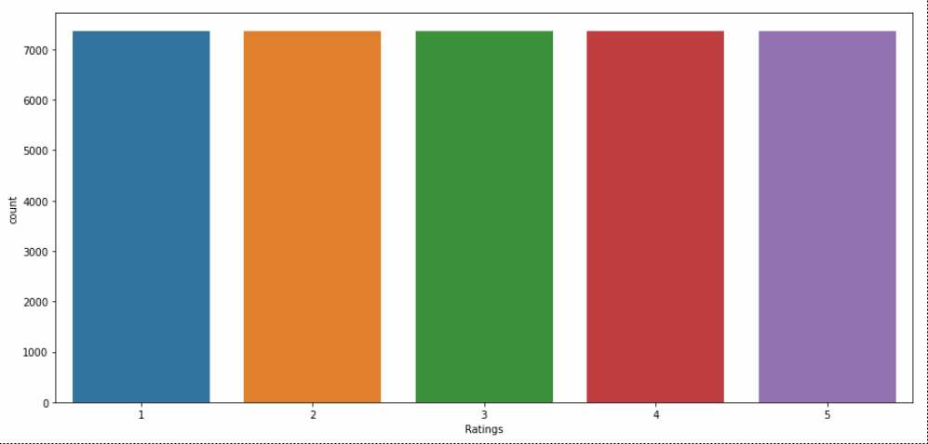
COUNT PLOTS
Generated these count plots before and after handling the data imbalance concern where we notice that the dataframe consisted of different number of rating reviews that needed to be equalized.

Slide 15
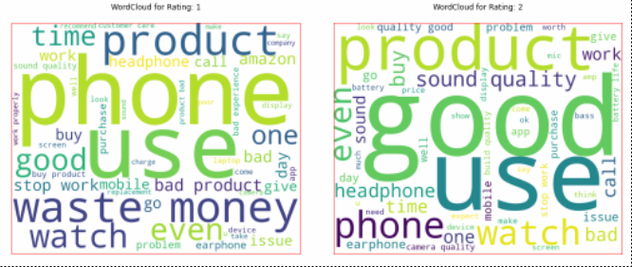
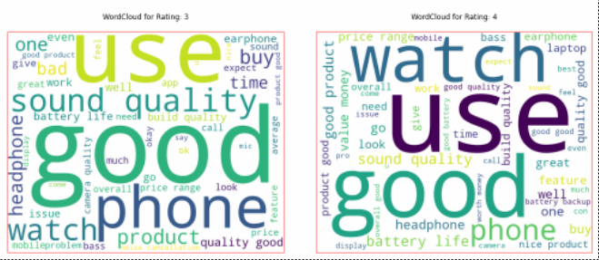
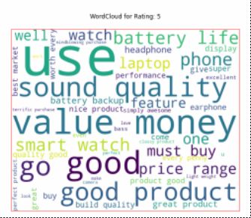
WORD CLOUD
Word Cloud as the name suggests is a cloud of words. It is a visualization technique for text data wherein each word is picturized with its importance in the context or its frequency.

Slide 16
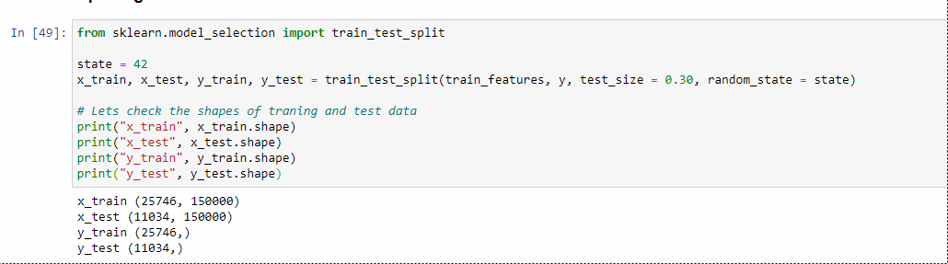
SPLITTING THE DATA
We split our dataset into two parts training and testing, with 70% data of training and 30% of testing. We use train test split method.
70% of the observation as training set. x_train
The associated target for each observation in x_train , y_train
30% of the observation as test. x_test
The target associated with the test set. y_test
We found best score on random_state = 42

Slide 17
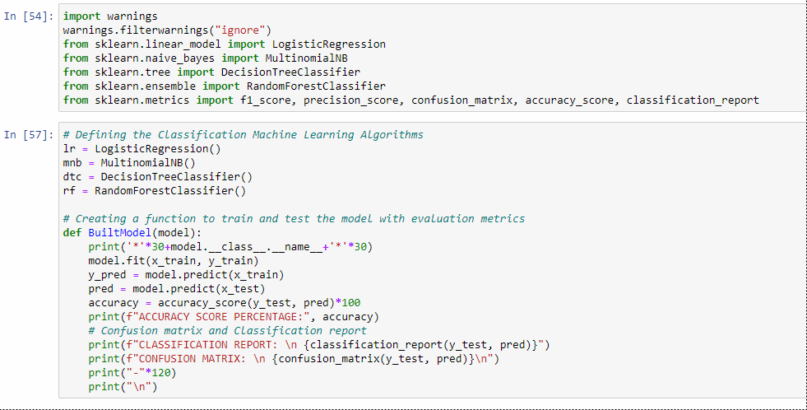
MODEL DEVELOPMENT ALGORITHMS
The complete list of algorithms that were used in training and testing the classification model are listed below:
Logistic Regression
Multinomial Naïve Bayes
Decision Tree Classifier
Random Forest Classifier

Slide 18
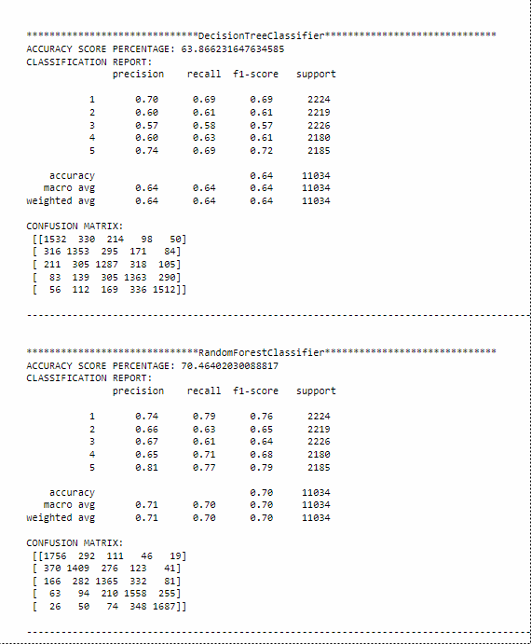
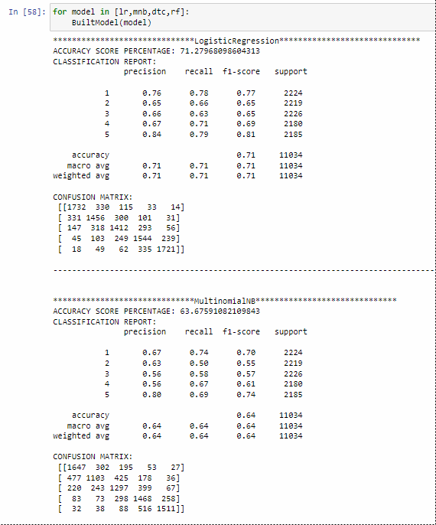
Evaluation of ML Models

Slide 19
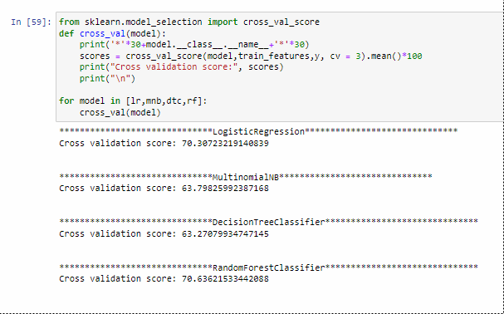
Cross Validation of ML Models

Slide 20
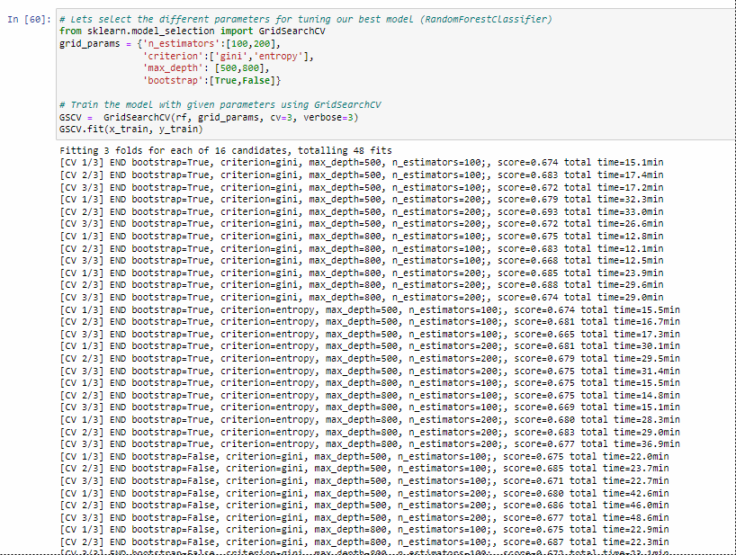
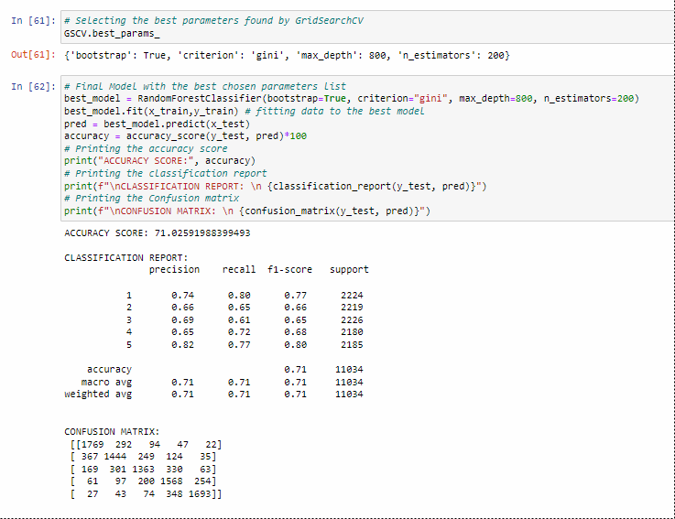
Hyperparameter Tuning

Slide 21
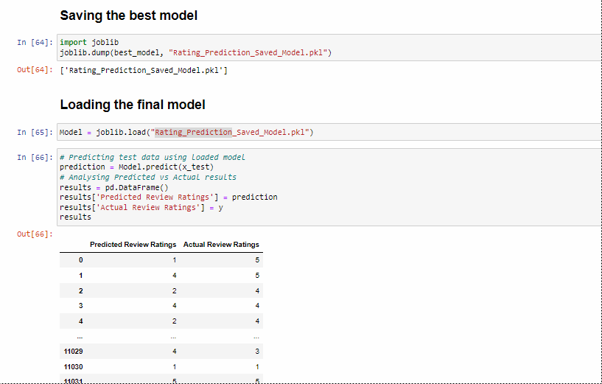
Saving and Loading the model

Slide 22
Conclusion
Key findings of the study: In this project I have collected data of reviews and ratings for different products from amazon.in and flipkart.com. Then I have done different text processing for reviews column and chose equal number of text from each rating class to eliminate problem of imbalance. By doing different EDA steps I have analyzed the text. We have checked frequently occurring words in our data as well as rarely occurring words. After all these steps I have built function to train and test different algorithms and using various evaluation metrics I have selected Random Forest Classifier as our final model. Finally by doing hyperparameter tuning we got optimum parameters for our final model. And finally we got improved accuracy score for our final model.

Slide 23
Limitations of this work and scope for the future work: As we know the content of text in reviews is totally depends on the reviewer and they may rate differently which is totally depends on that particular person. So it is difficult to predict ratings based on the reviews with higher accuracies. Still we can improve our accuracy by fetching more data and by doing extensive hyperparameter tuning.
Areas of improvement:
Less time complexity
More computational power can be given
More accurate reviews can be given
Many more permutations and combinations in hyper parameter tuning can be used to obtain better parameter list
Final Remarks: After applying the hyper parameter tuning the best accuracy score obtained was 71.025% which can be further improved by obtaining more data and working up through other parameter combinations.

Slide 24
We were able to create a rating prediction model that can be used to identify rating details just by evaluating the comments posted by a customer.

Slide 25


